Slide 1
Linear Regression
ADA AI/ML - april, 2023

Slide 2
What is regression
Regression searches for relationships among variables. For example, you can observe several employees of some company and try to understand how their salaries depend on their features, such as experience, education level, role, city of employment, and so on.
Regression problems usually have one continuous and unbounded dependent variable. The inputs, however, can be continuous, discrete, or even categorical data such as gender, nationality, or brand.
In machine learning, regression is a subtype of supervised learning.

Slide 3
When do you need regression
Typically, you need regression to answer whether and how some phenomenon influences the other or how several variables are related.
Regression is also useful when you want to forecast a response using a new set of predictors. For example, you could try to predict electricity consumption of a household for the next hour given the outdoor temperature, time of day, and number of residents in that household.
Regression is used in many different fields, including economics, computer science, and the social sciences.

Slide 4
Linear regression - concept
A linear regression is a statistical model that analyzes the relationship between a response variable (Y) and one or more input variables (X) that are also referred to as predictor or explanatory variables.
We can use this model to predict Y when X is known (note that X is a vector of values (x1, x2, . . . xn)). The mathematical equation can be generalized as follows: Y = a + BX,
where a is known as the intercept, whereas B are coefficients of the predictor variables. Collectively, these are referred to as regression coefficients.

Slide 5
Linear regression - concept
Linear regression calculates the estimators of the regression coefficients or simply the predicted weights, denoted with 𝑏₀, 𝑏₁, …, 𝑏ᵣ. These estimators define the estimated regression function 𝑓(𝐱) = 𝑏₀ + 𝑏₁𝑥₁ + ⋯ + 𝑏ᵣ𝑥ᵣ. This function should capture the dependencies between the inputs and output sufficiently well.
The estimated or predicted response, 𝑓(𝐱ᵢ), for each observation 𝑖 = 1, …, 𝑛, should be as close as possible to the corresponding actual response 𝑦ᵢ. The differences 𝑦ᵢ - 𝑓(𝐱ᵢ) for all observations 𝑖 = 1, …, 𝑛, are called the residuals. Regression is about determining the best predicted weights—that is, the weights corresponding to the smallest residuals.
To get the best weights, you usually minimize the sum of squared residuals (SSR) for all observations 𝑖 = 1, …, 𝑛: SSR = Σᵢ(𝑦ᵢ - 𝑓(𝐱ᵢ))². This approach is called the method of ordinary least squares.

Slide 6
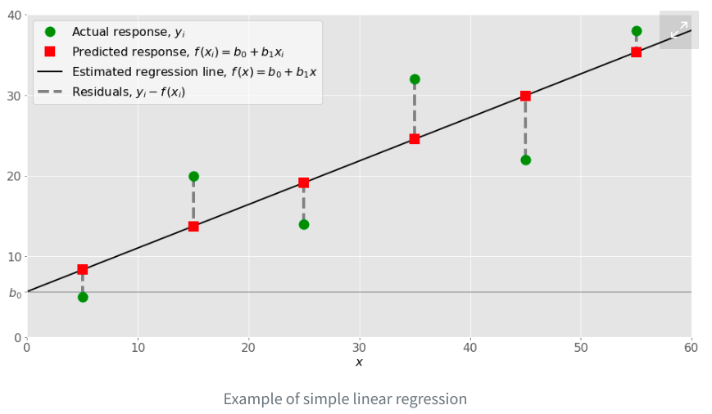
Simple linear regression
Simple or single-variate linear regression is the simplest case of linear regression, as it has a single independent variable, 𝐱 = 𝑥.
𝑓(𝑥) = 𝑏₀ + 𝑏₁𝑥. The goal is to calculate the optimal values of the predicted weights 𝑏₀ and 𝑏₁ that minimize SSR and determine the estimated regression function.
The value of 𝑏₀, also called the intercept, shows the point where the estimated regression line crosses the 𝑦 axis. The value of 𝑏₁ determines the slope of the estimated regression line.

Slide 7
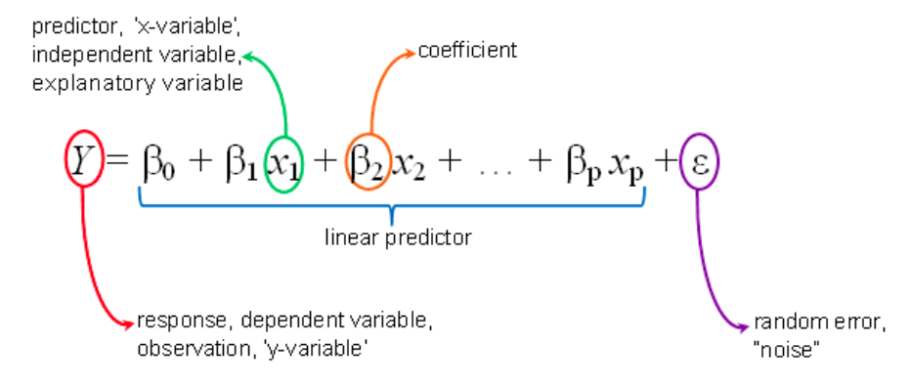
Multiple linear regression
Multiple or multivariate linear regression is a case of linear regression with two or more independent variables: 𝑓(𝑥₁, …, 𝑥ᵣ) = 𝑏₀ + 𝑏₁𝑥₁ + ⋯ +𝑏ᵣ𝑥ᵣ
If there are just two independent variables, then the estimated regression function is 𝑓(𝑥₁, 𝑥₂) = 𝑏₀ + 𝑏₁𝑥₁ + 𝑏₂𝑥₂. It represents a regression plane in a three-dimensional space.

Slide 8
Key assumptions of linear regression
Linearity: there is a linear relationship between features and responses. This is required for an estimator and predictions to be unbiased.
No multicollinearity: features are not correlated. If this is not satisfied, an estimator will suffer from high variance.
Normality of residuals
Homoskedasticity: the variance of residuals remains more or less constant across the regression line. If this is not satisfied, there will be other linear estimators with lower variance.
No high leverage points (observations that have unusually high/low predictor values are considered to have high leverage).

Slide 9
Evaluation metrics
There are several error metrics that are commonly used for evaluating and reporting the performance of a regression model; they are:
Mean Absolute Error (MAE)
Mean Squared Error (MSE)
R-squared
Adjusted R-squared
Root Mean Squared Error (RMSE)

Slide 10
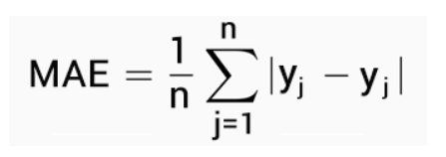
Mean Absolute Error (MAE)
MAE is simply the average of the absolute difference between the target value and the value predicted by the model. It is not preferred in cases where outliers are prominent. MAE does not penalize large errors.

Slide 11
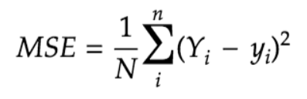
Mean Squared Error (MSE)
MSE is the most common metric for regression tasks. It has a convex shape. It is the average of the squared difference between the predicted and actual value. Since it is differentiable and has a convex shape, it is easier to optimize. MSE penalizes large errors.

Slide 12
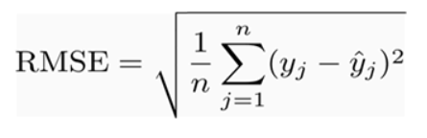
Root Mean Squared Error (RMSE)
RMSE is the square root of the average of the squared difference of the predicted and actual value. Since residuals are a measure of how distant the points are from the regression line, RMSE measures the scatter of these residuals.

Slide 13
R² (R-squared )
R-squared or Coefficient of Determination represents the part of the variance of the dependent variable explained by the independent variables of the model. It measures the strength of the relationship between the model and the dependent variable.
R-squared = 1 - Residual sum of squares (RSS) / Total sum of squares (TSS)
RSS/TSS - represents the part of the variance of Y, described by the dependent variables.

Slide 14
R² (R-squared )
If the data points are very close to the regression line, then the model accounts for a good amount of variance, thus resulting in a high R² value.
However, a good model can have low R² value and a biased model can have a high R² value as well. That is the reason why diagnostic (residual) plots should be used to check the model.
It is not possible to see a model with an R² of 1. In that case, all predicted values are the same as actual values and this essentially means that all values fall on the regression line.

Slide 15
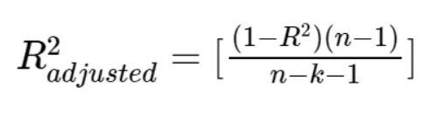
Adjusted R² (R-squared )
The main difference between adjusted R-squared and R-square is that R-squared describes the amount of variance of the dependent variable represented by every single independent variable, while adjusted R-squared measures variation explained by only the independent variables that actually affect the dependent variable.
R² tends to increase with an increase in the number of independent variables. This could be misleading. Thus, the adjusted R-squared penalizes the model for adding furthermore independent variables (k in the equation) that do not fit the model.

Slide 16
Underfitting and Overfitting
Underfitting occurs when a model can’t accurately capture the dependencies among data, usually as a consequence of its own simplicity. It often yields a low 𝑅² with known data and bad generalization capabilities when applied with new data.
Overfitting happens when a model learns both data dependencies and random fluctuations. In other words, a model learns the existing data too well. Complex models, which have many features or terms, are often prone to overfitting. When applied to known data, such models usually yield high 𝑅². However, they often don’t generalize well and have significantly lower 𝑅² when used with new data.

Slide 17
Pros & Cons
Pros
Simple model
Computationally efficient
Interpretability of the Output
Cons
Overly-simplistic
Linearity and other assumptions
Severely affected by Outliers

